Slide 1
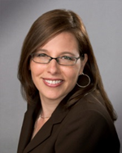
Boomers Going Solo: It’s Your Time to Launch!
Shira Harrington
Purposeful Hire, Inc.

Slide 2
22%
Percentage of temporary / contract workers in the 200 largest companies in the US

Slide 3
50%
Number of Americans who will be freelancers by 2020
One in three -- roughly 42 million -- is already an independent worker.

Slide 4
$1.2 Trillion
The amount of total income generated by freelancers in 2013 (up 20% from 2012)

Slide 5
What’s causing this trend?
Hiring FTEs is expensive.
Business competition has increased.
Internet has made hiring project workers easier.

Slide 6
Highest Rate of Entrepreneurial Activity is Among Boomers
¼ of all business are started by people ages 55 – 64
People over 55 are almost twice as likely to create successful startups as those ages 20 to 34
Long-term unemployment and age discrimination has created “necessity entrepreneurs”

Slide 7
“I find a lot of people taking initiative in their mid-50s. Especially since the Great Recession of 2008, there’s been this shift in view of what stable employment is and there’s been a willingness [for people] to recreate [themselves]. Maybe they’ve been downsized or laid off and long-term unemployment benefits have been suspended and they’ve had to get creative about restarting.”
--Beth Roalsted,
Innovations in Aging Collaborative

Slide 8
“A senior’s chance of getting rehired if they are out of work for more than a year is less than 10 percent,” she said, adding that instead of seniors continuing to look for jobs they are not likely to land in order to collect unemployment, they should be able to invest benefits in entrepreneurship training and as seed money for new businesses without making a minimum number of job contacts.
--Elizabeth Isele
Senior Entrepreneurship Works

Slide 9
Objections that Boomers Raise
The cyclical nature of securing clients
Losing personal savings
Not having a safety net
Losing benefits
Decreasing work-life balance

Slide 10
Potential Stumbling Blocks
Discouragement at the first glitch
Expecting immediate results
Lack of support from family/friends
Insecurity about your abilities
Keeping the pipeline full

Slide 11
What it Takes to Succeed
Having a passion to serve
Understanding your gifts
Know what problems you can help solve
Commitment to networking and thought leadership
Being a “Possibilitarian”
(Have a WHY that’s bigger than your BUT)

Slide 12
Getting Started!
1. Find your TRIBE and LANE
2. Focus on ONE problem to solve
3. Do your market research
4. Develop a business model
5. Develop branding materials
(website, LinkedIn, business cards)
6. Network within your tribe or lane
7. Become a thought leader

Slide 13
WHO
You Serve
(Your Tribe)
HOW
You Serve
(Your Lane)
WHY
You Serve
(Your Value)
In what WAY
You Serve
(Your Offerings)

Slide 14
Passiontivity Exercise (Find Your Lane)
High Motivation
(Highly Engaged) (Areas of Professional
Development)
High Skill Low Skill
(Stop-Gap Work) (Don’t Do It!)
Low Motivation

Slide 15
Small Business Motivators
What is your fee?
How Do You Want to be Compensated? Hourly, Project, Retainer?
Pick your lane(s) or highway
Who
What
Where
When
Why
How
How Much
Pick your tribes(s)
What are your personal strengths?
How Do You Want to Work?
How Much Do You Want to Outsource or Subcontract?
Work-life balance / Travel / Commute
Why Are You in Business?
What is your legacy?

Slide 16
Practical Tips
Choose to be a sole proprietor, LLC or S-Corp
Host your URL (GoDaddy, BlueHost)
Select a website builder and website host
(GoDaddy, Wix, Weebly, Squarespace, Branded.Me)
Get business cards (VistaPrint)
Host your email (Office 365)
Backup your hard drive (Carbonite)
Hire an accountant
Consider legal support (LegalZoom)

Slide 17
Resources
Life Reimagined www.lifereimagined.aarp.org
SCORE www.score.org
Small Business Administration: https://www.sba.gov/content/50-entrepreneurs
Kaufmann Foundation www.kaufmann.org
Senior Entrepreneurship Works www.seniorentrepreneurship.org www.savvyseniorswork.com (blog)
BoomerWorks (volunteers needed)
Email shira@purposefulhire.com

Slide 18
Group Exercise
1. Complete Passiontivity
2. What is your most prominent gift?
3. Could you see yourself using this gift full time?
4. Who would most benefit from it and WHY?
5. What would be your first step to get started?

Slide 19
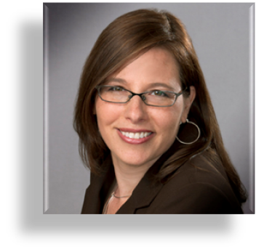
Thank you!
Shira Harrington
Purposeful Hire, Inc.
703-508-9573
shira@purposefulhire.com
www.purposefulhire.com

